Slide 1





WELCOME!
Your Food Partners in Humanitarian Efforts

Slide 2

ABOUT OUR BUSINESS
  Delivering quality food products worldwide
Indrayani Overseas has been a prominent player in agricultural commodity trading since 1998, serving as a top importer of rice and other groats to Ukraine. We offer a diverse range of imported grains, beans, and lentils, as well as locally produced grains. Additionally, Indrayani Overseas plays its role in supporting Ukrainian agriculture by exporting unique niche products such as peas, linen seeds etc.
Gala Foods, established in 2015, is a packaging company. We are the only BRC certified cereal packaging plant in Ukraine, ensuring the highest quality standards. Gala Foods efficiently packs grains, beans, cereals, and sugar for our own brands and private labels, distributing them to major Ukrainian retailers and established European chains. We are capable to offer a wide range of private label custom weight solutions.

Slide 3



OUR BUSINESS IN NUMBERS
25+
Years of experience
and market expertise
50+
Returning customers
all over the world
9+
10+
Years on the market
Retail chains offer our products
International commodity trader
Multiple equipped warehouses accross the country
Established partner relationships
BRC and ISO 22000 certified plant
Active exporter of Ukrainian goods
Multi-brand portfolio and private label oppotunities

Slide 4
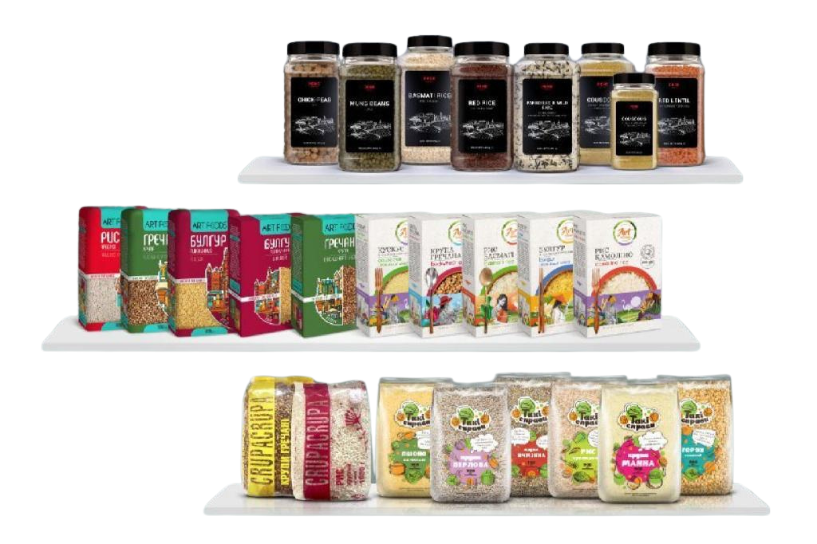
GALA FOODS BRANDS
  Present in most of Ukraine’s retail chains
TM “PERE”
TM “ART FOODS”
TM “TAKI SPRAVY”

Slide 5

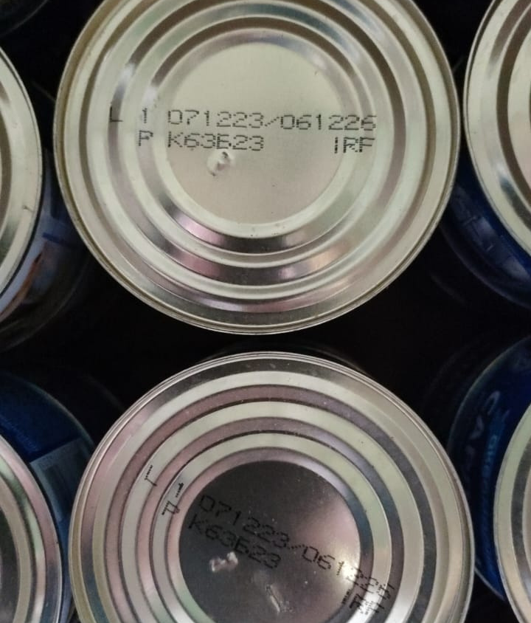
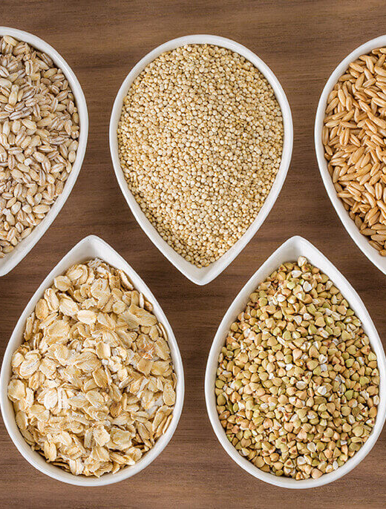
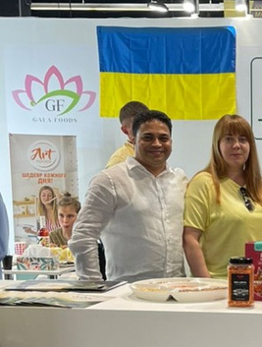
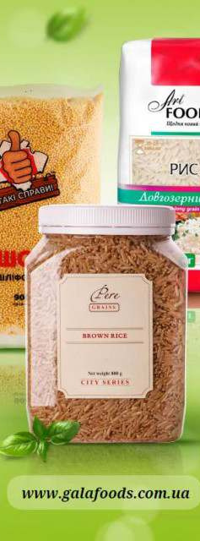
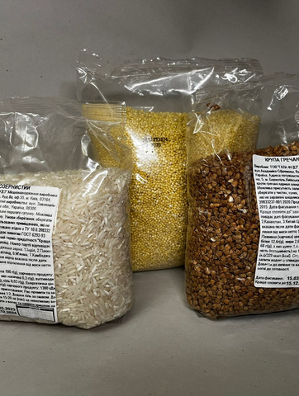
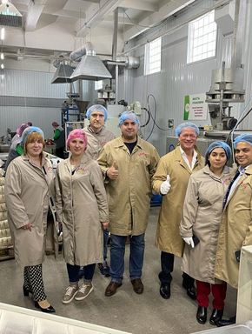
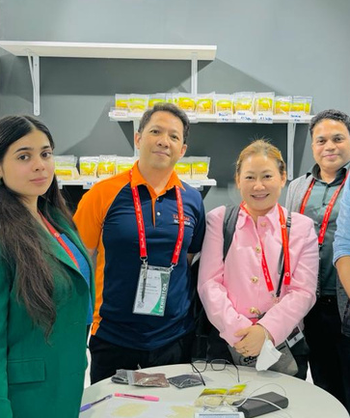
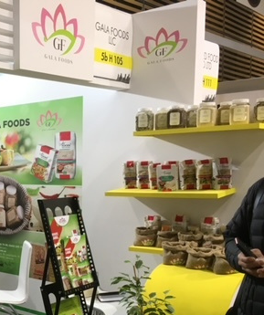
Humanitarian Aid Partner
Our group of companies has been a reliable partner for impactful aid since 2022: we processed over 1,800 tons of humanitarian aid orders (individual goods, packed items, bulk grains/sugar).
  Offering private label packaging for humanitarian organizations and retail chains;
  Established a network of reliable Ukrainian food item suppliers for essential items (sunflower oil, canned goods, etc.).
1800 MT
80+
of humanitarian aid delivered
million UAH worth of goods

Slide 6











OUR UKRAINIAN SUPPLIER NETWORK
  Offering guaranteed quality products

Slide 7
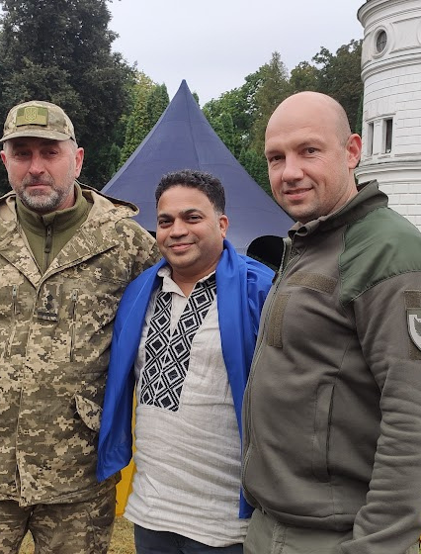


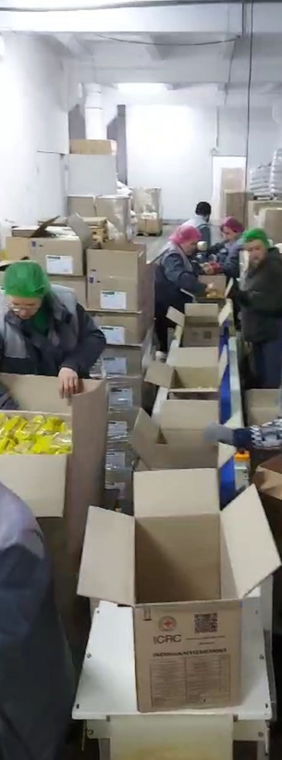

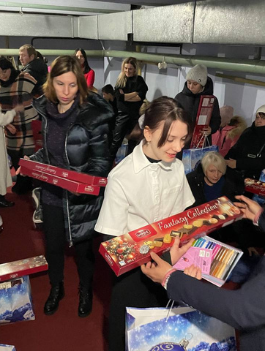
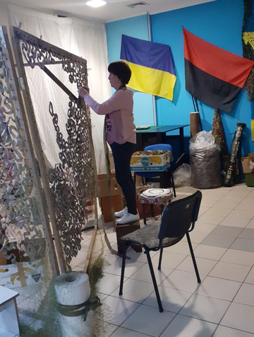

Corporate
Social
Responsibility
01
Our motto is “Ukrainian products for Ukrainian people”, as we focus on delivering aid produced in Ukraine to Ukraine, offering it abroad.
Kindness is both a virtue and a blessing
We donate a substantial amount of our products to shelters, field kitchens and volunteers all around Ukraine since 2022.
02
03
Our business actively supports non-profit organizations like “Battalion Setka”, “Armiia Volonteriv” and “Borscht dla ZSU” since 2014.
The owner of the company, Ram Dange, actively participates in creating opportunities for our business to contribute to humanitarian efforts.
04

Slide 8
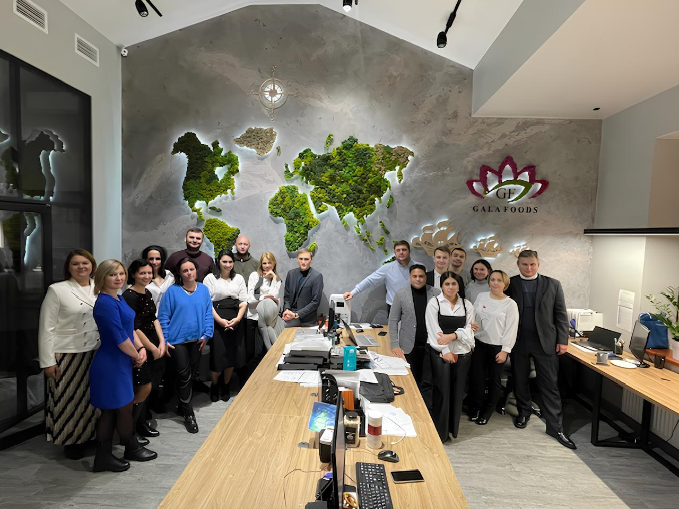




Contacts
ram.dange@indrayani.com.ua
vp@indrayani.com.ua
www.indrayani.com.ua www.galafoods.com.ua
Kyiv, Ukraine
+380502819644

